Slide 1
OOPS

Slide 2
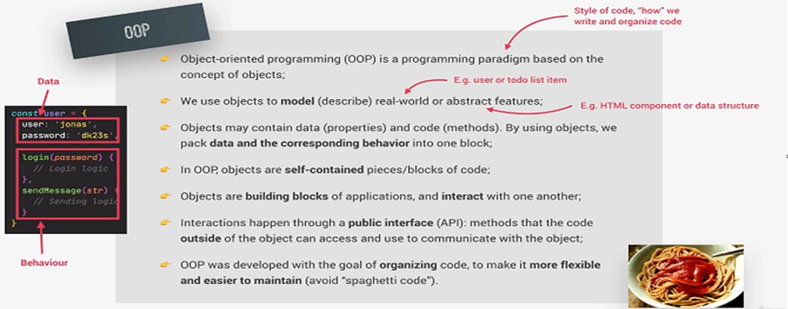
Object Oriented Programming

Slide 3
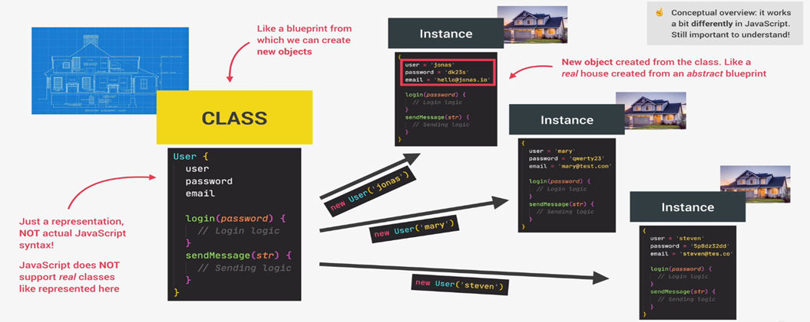
Classes And Instances

Slide 4
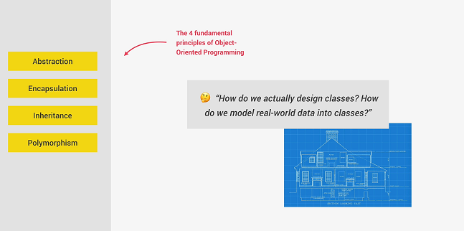
Fundamental of OOPS

Slide 5
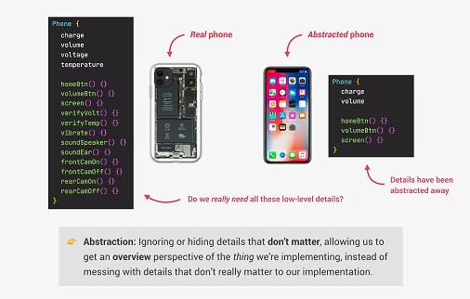
Abstraction

Slide 6
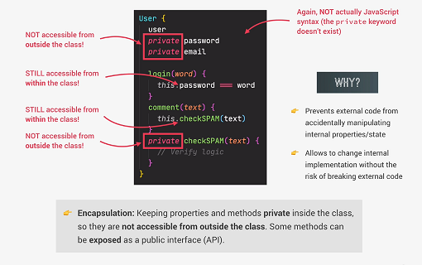
Encapsulation

Slide 7
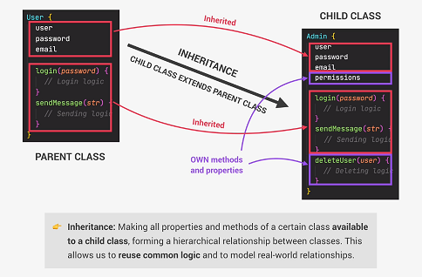
Inheritance

Slide 8
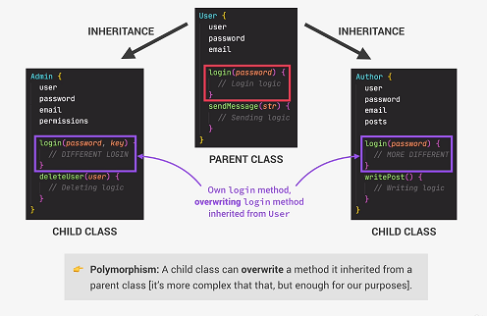
Polymorphism

Slide 9
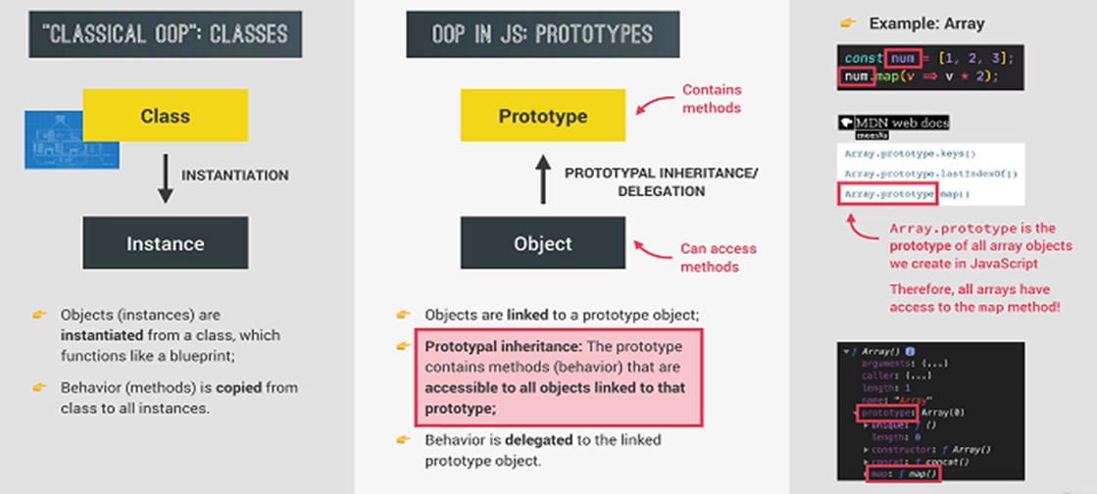
OOPS in Javascript

Slide 10
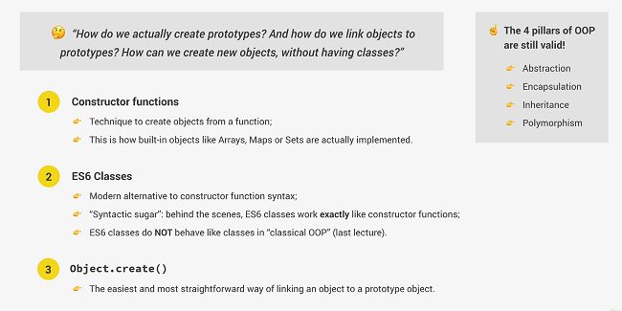
3 Ways of Implementing Prototypal Inheritance in Javascript

Slide 11
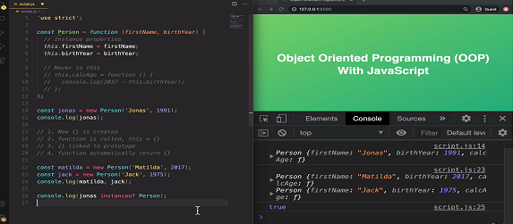
Constructor Function

Slide 12
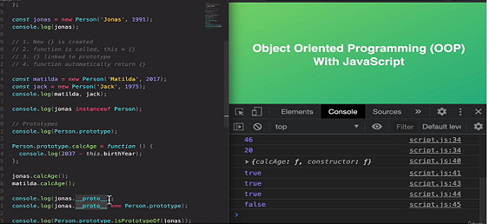
Prototypes

Slide 13
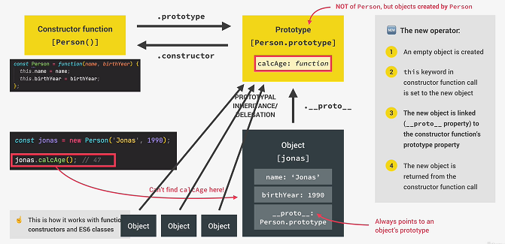
How Prototypal Inheritance

Slide 14
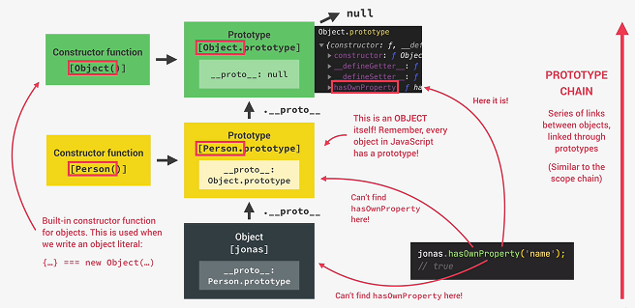
Prototype Chain

Slide 15
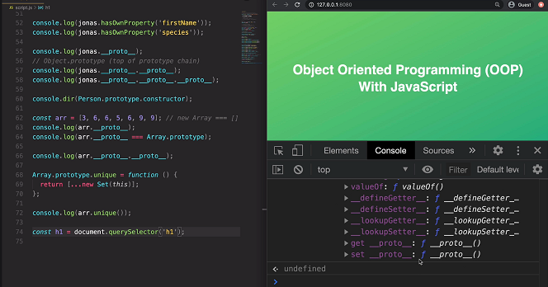
Prototypal Inheritance on Built in Objects

Slide 16
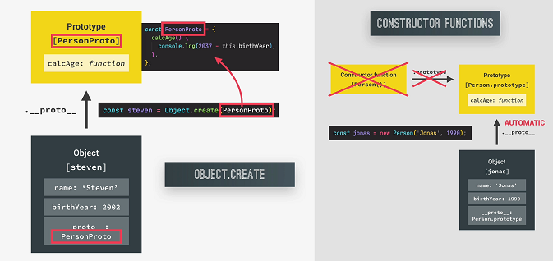
How Object.create Works

Slide 17
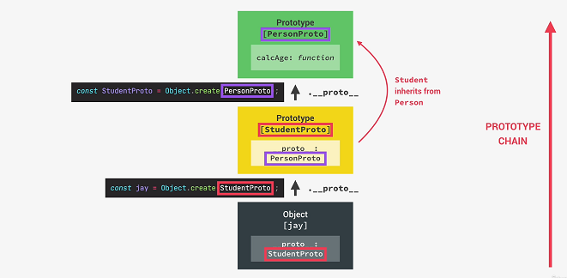
Inheritance in Object.create

Slide 18
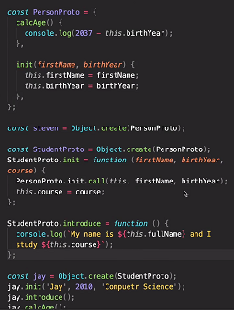
Inheritance – Object.create

Slide 19
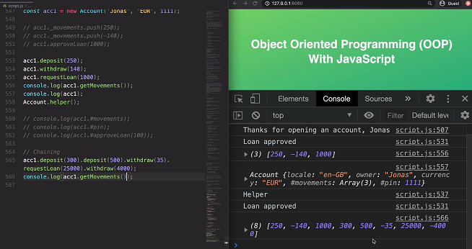
Chaining Methods

